Slide 1
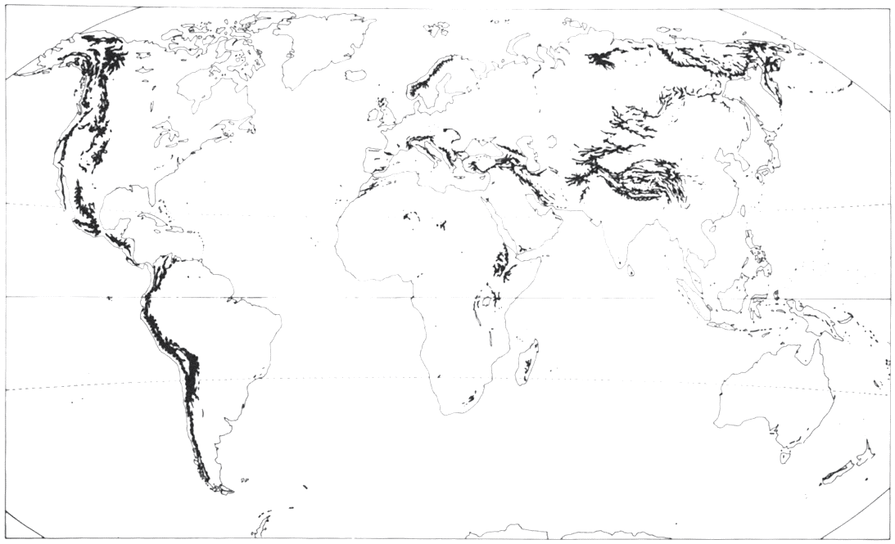
Mountain grassland dynamics: integrating phenotypic plasticity in a new agent-based model
Ph.D. defence of
Clément Viguier
realised under the supervision of
Björn Reineking
at IRSTEA Grenoble - EMGR

Slide 2
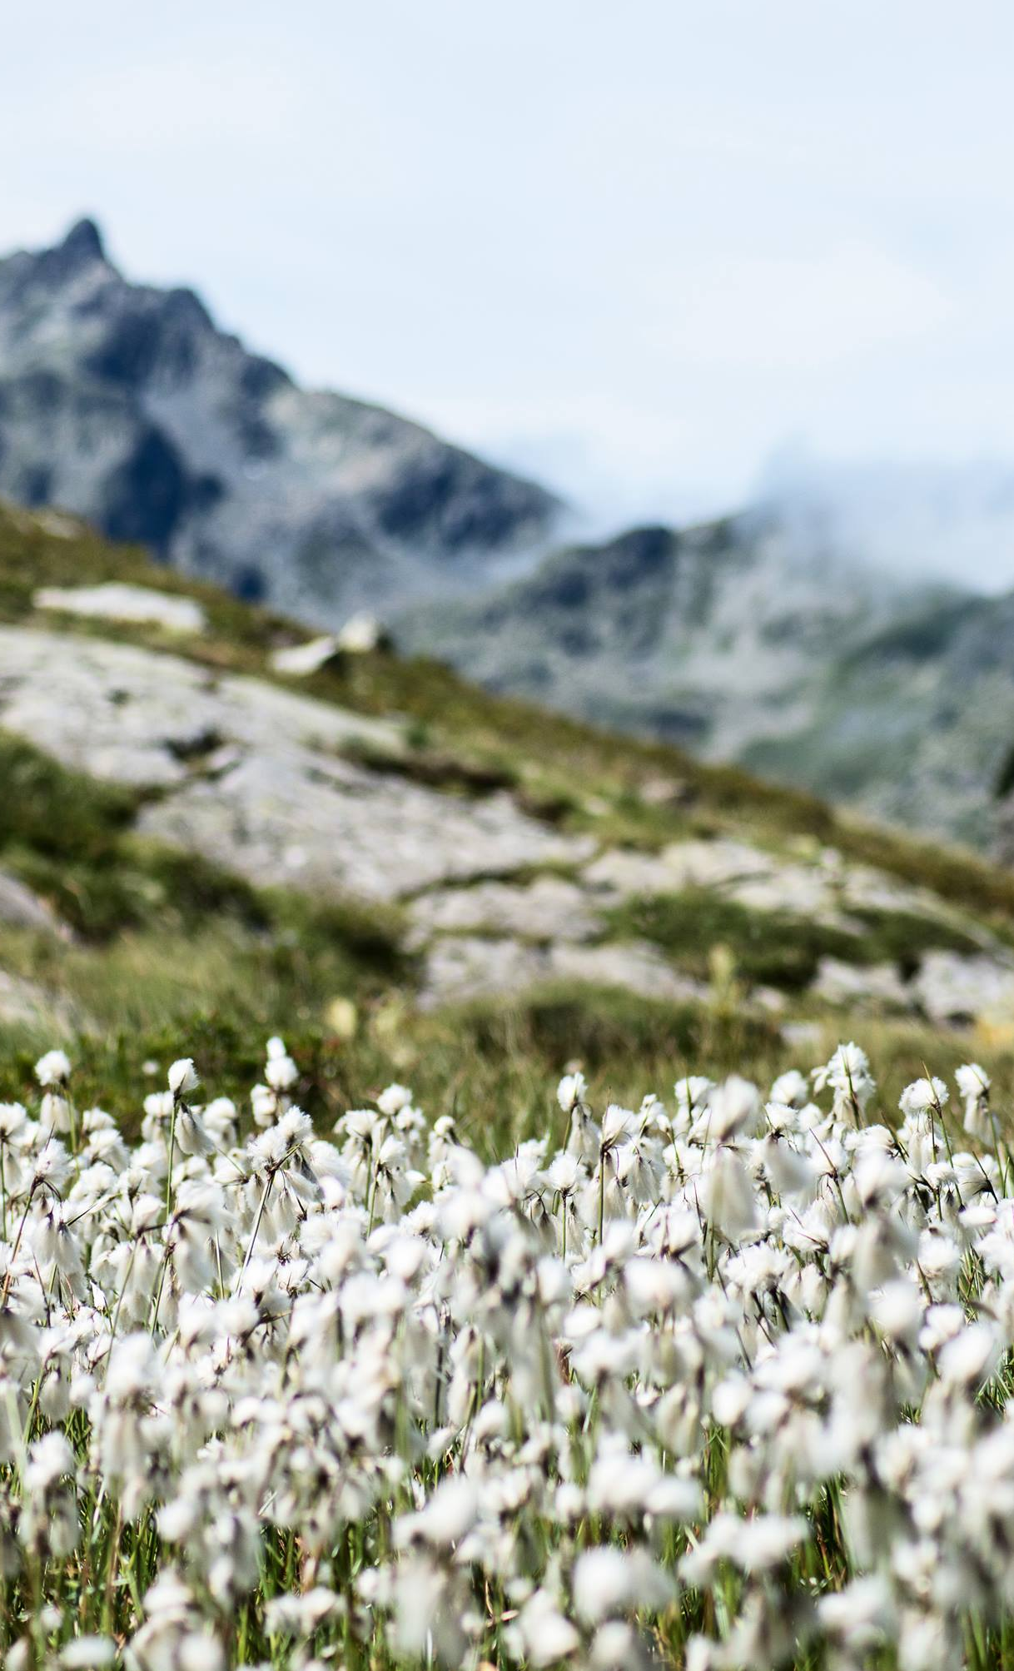
Context
1
Mountain grasslands in a changing world

Slide 3
High diversity of mountain grasslands

Slide 4
Ecosystem services

Slide 5
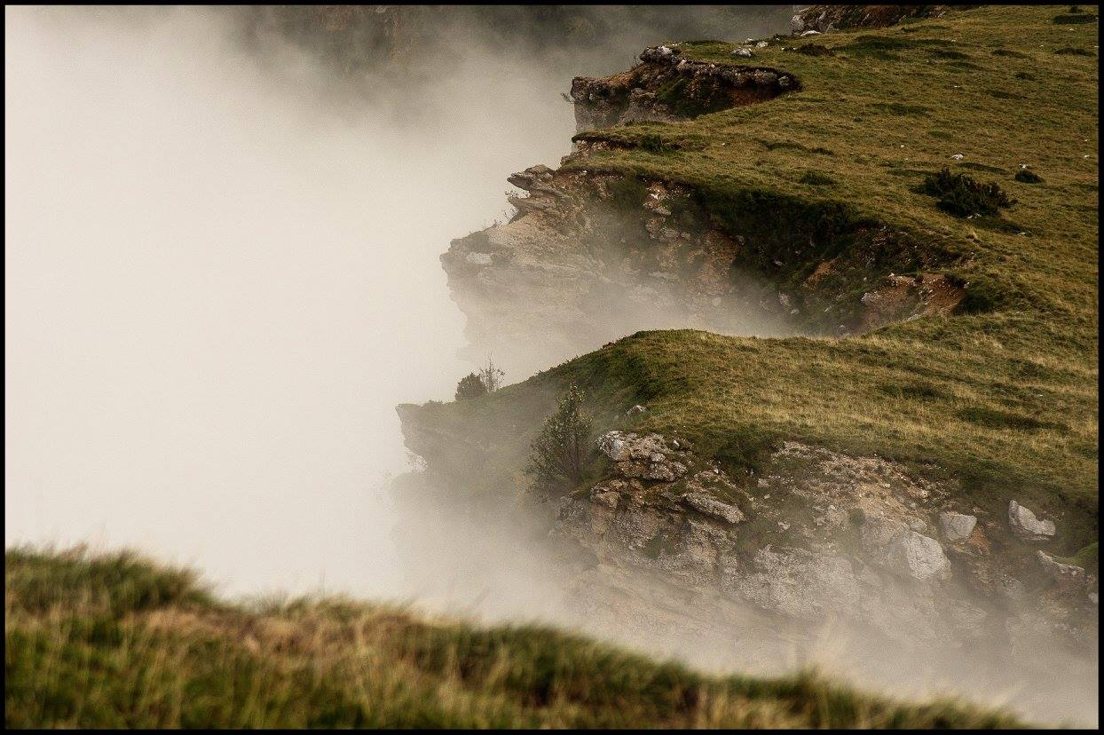
Questions
2
Conceptual and scientific interrogations

Slide 6
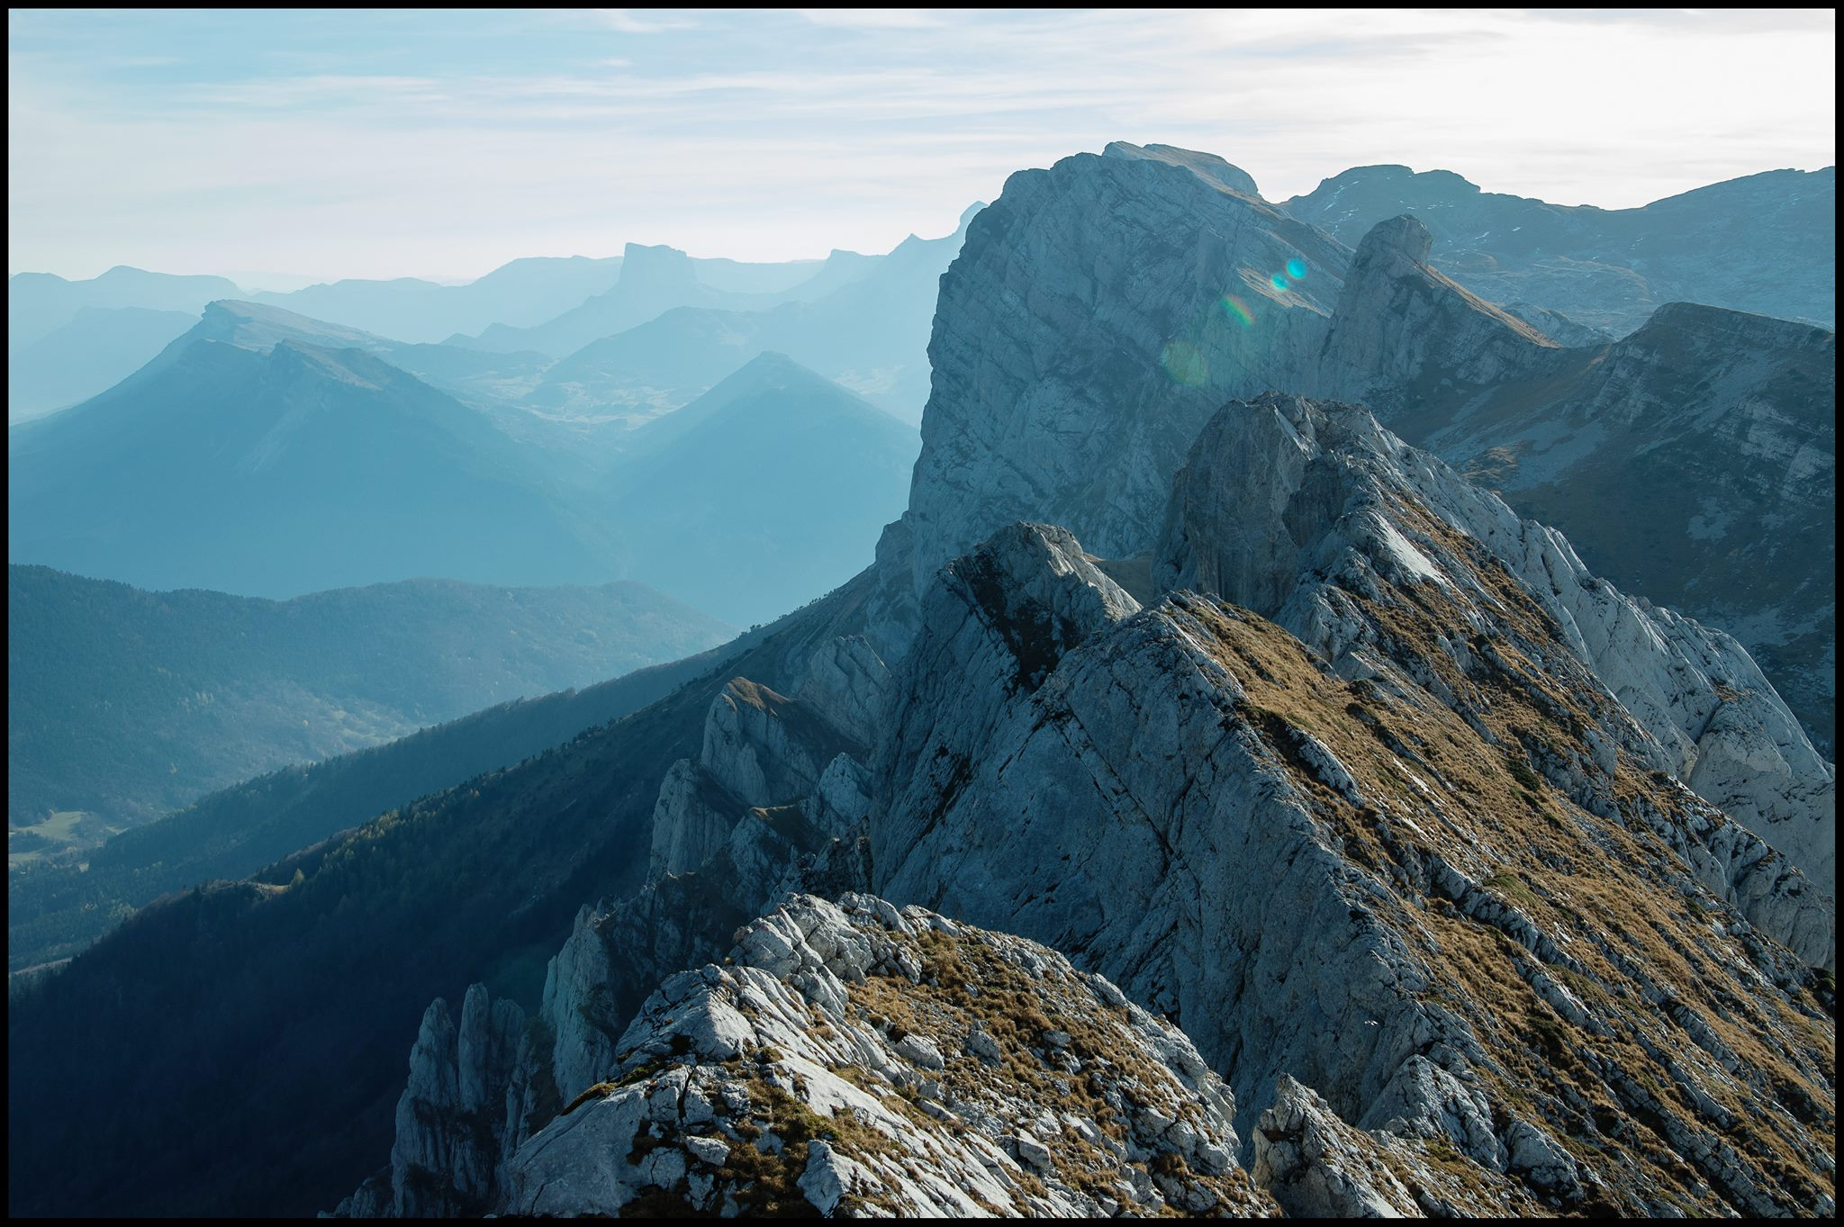
Introducion
3
State of the art, concepts and model presentation

Slide 7
State of the art

Slide 8
Conceptual framework

Slide 9
The concept of niche

Slide 10
Trade-offs for a diverse community framework

Slide 11
Modelling plasticity
Active vs passive: plasticity as a strategy

Slide 12
Modelling plasticity
Plasticity in models: dimensions, objectives and assumptions

Slide 13
Model overview

Slide 14
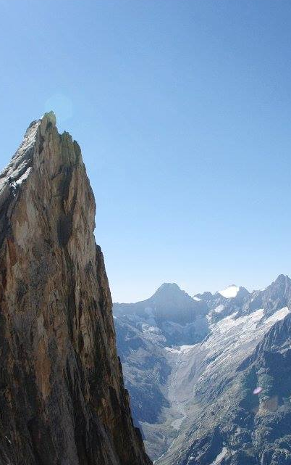
Results
4
Individual- and community-level effects of plasticity

Slide 15
From the individual to the community.
INDIVIDUAL
COMMUNITY
Understand components of plant growth
Link strategies and the potential niche
Study the effect of plasticity on potential niche
Test realised effects on community properties
Understand the balance between filtering mechanisms

Slide 16
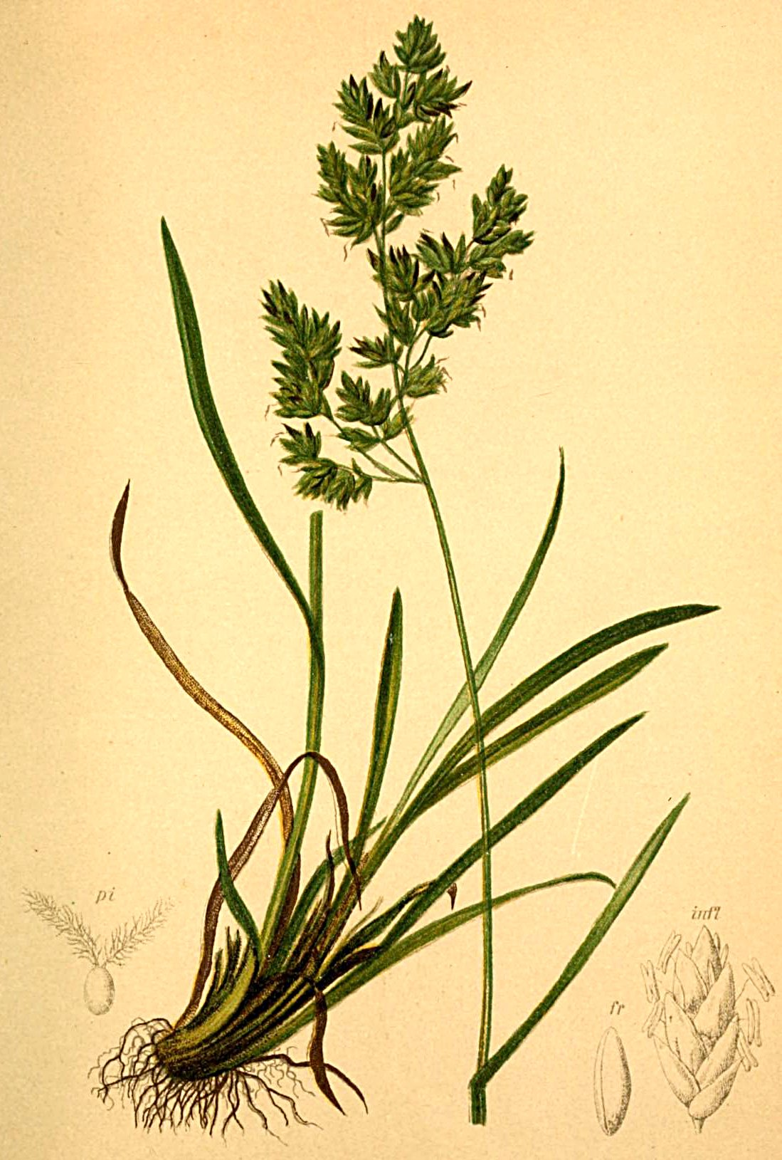
Individual-level simulations
The plasticity and the potential niche

Slide 17
Components of plant growth
NET EXCHANGE RATE
EQUILIBRIUM

Slide 18
Static gain in homogeneous conditions

Slide 19
Consequences: widening of potential niche

Slide 20
Dynamic gain in heterogeneous conditions

Slide 21
Consequences: shift in dominant strategy

Slide 22
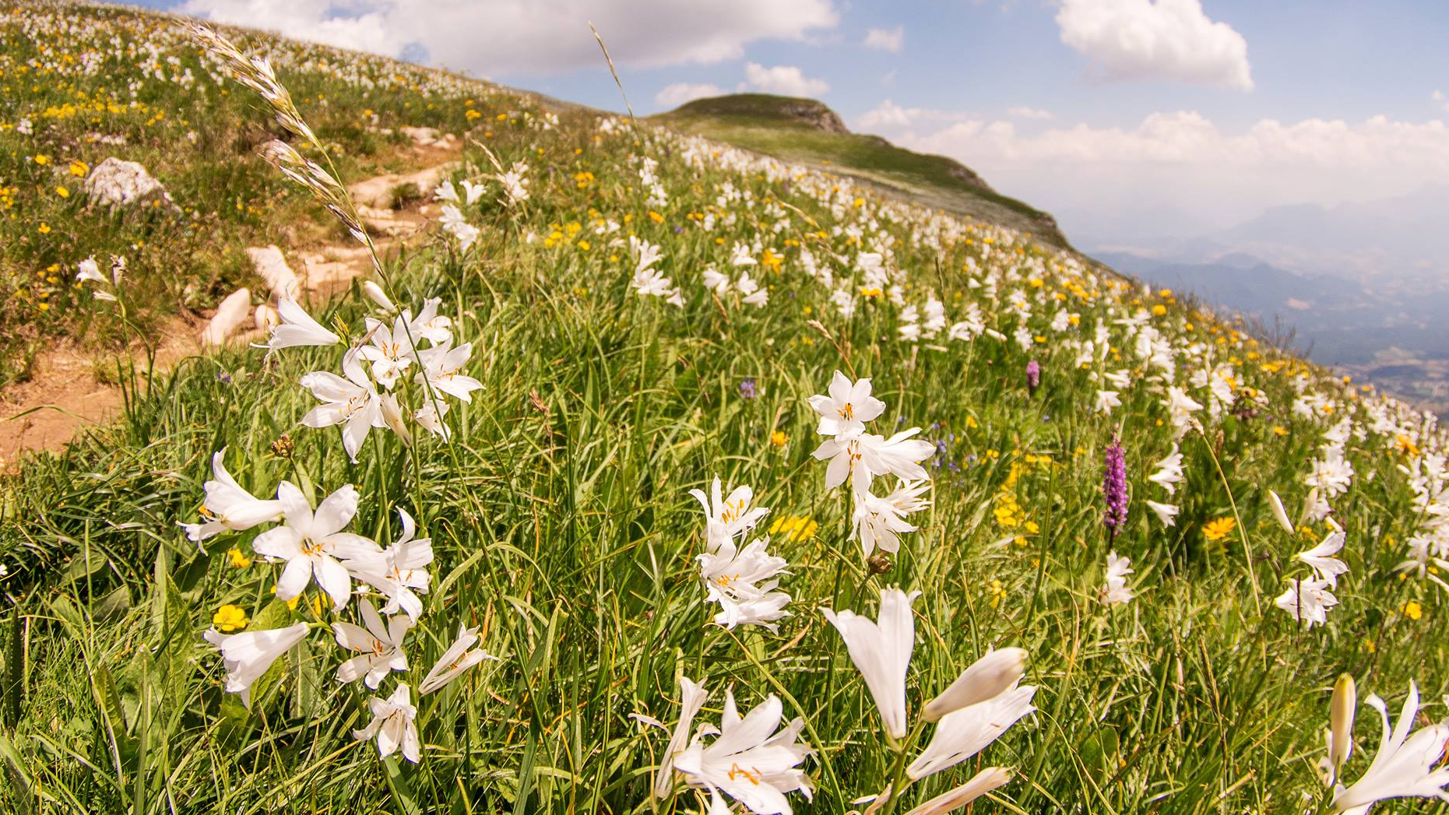
Community-level simulations
Community structure and diversity

Slide 23
Effect of the niche widening on diversity

Slide 24
Dominant strategies and community structure
Effect on dominant strategy
Different meta-community structure

Slide 25
Limits of the interpretation
Plasticity effect may be due to poor trait selection in the first place
Plasticity facilitates the exploration of strategy space

Slide 26
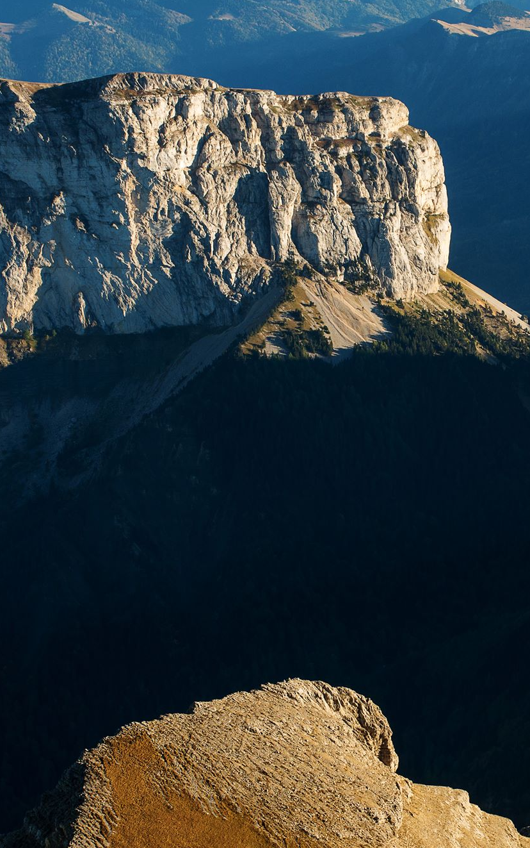
Discussion
5
Impact on community dynamics and community modelling

Slide 27
Commmunity dynamics and stability
Results → hypothesis → simulation plan + limitations
Community instability and overlap → soft abundance changes, not critical transition → establish stable communities (better exploration of trait space

Slide 28
Convergence vs divergence

Slide 29
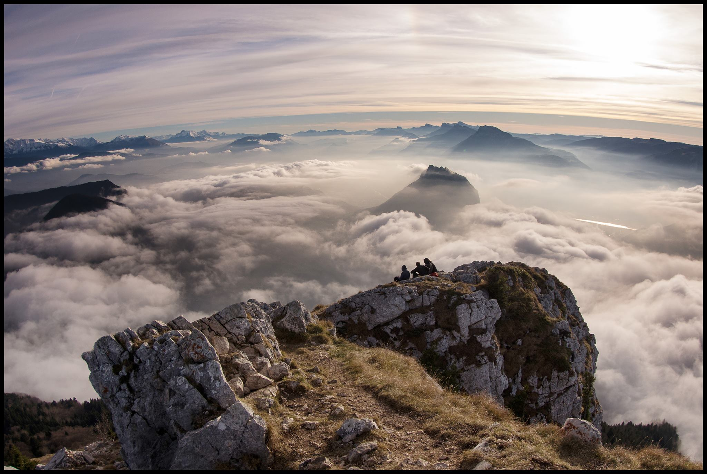
Conclusion & Perspectives
6
New hypothesis and simulations
Model developments

Slide 30
Diverse community framework

